Slide 1
Visual Studio Team System & TFS
Eralp Erat
Senior Software Developer
MCP,MCAD.NET,MCSD.NET

Slide 2














Visual Studio Team System Supporting the whole of the Application Life Cycle
Designer
Developer
Database Professional
Architect
Tester
Business
Analyst
IT / Project Manager
Team
Collaboration
Software
Quality
Project
Transparency

Slide 3
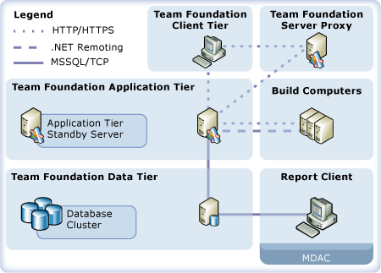
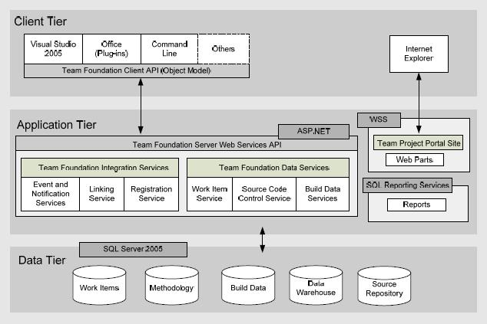
Look At!

Slide 4
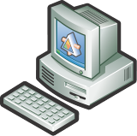

What is Team System?
Visual Studio Client Tools
Additional tools that extend Visual Studio for:
Architects
Developers
Database Professionals
Testers (including load testing)
Team Foundation Server
Source Code Repository
Project Portal
Work Item Tracking
Project Reporting
Build Server

Slide 5

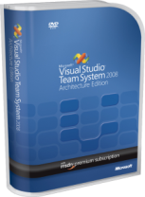




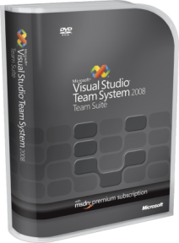
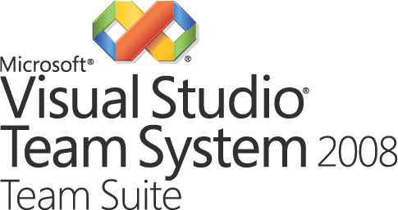
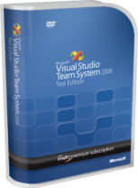



Visual Studio Client Tools
Simplify Project Conception
Design Project Deployment
Design Service Oriented Projects
Improve Code Quality
Increase Developer Efficiency
Manage Test Cases
Load Testing
Improve Communication
Schema Versioning
SQL Refactoring & Unit Testing
Data Generation

Slide 7
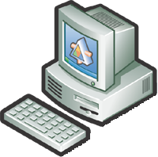













Visual Studio
Industry Partners
XML Web Services

Slide 8
Team Foundation Server

Slide 9
Team Foundation Server
Web Service Interface
SQL Server 2005
Analysis Services
Reporting Services
Windows SharePoint Services

Slide 10



Single Server Install
Web Service Interface
SQL Server 2005
Analysis Services
Reporting Services
Windows SharePoint Services
Single Server Install supports up to 450 Users

Slide 11


Dual Server Deployment
Dual Server Install supports up to 3600 Users

Slide 12

24 x 7 Availability
Standby App Server
Clustered Sql Server

Slide 13


Separate Build Server
Separate Build server takes load
off the TFS machine for
Continuous Integration
Standby App Server
Clustered Sql Server

Slide 14

Proxy Server
Proxy Server allows
fast connection for
distributed
development
teams

Slide 15
Team Collaboration
Supports your development process

Slide 16








Example Workflow
Bugs
Non Functional Requirements
Test
Use Case
Tasks
Business
Analyst
Dev Team
Change
Requests
Project
Manager
Production
Errors
Operations

Slide 17


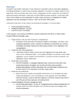
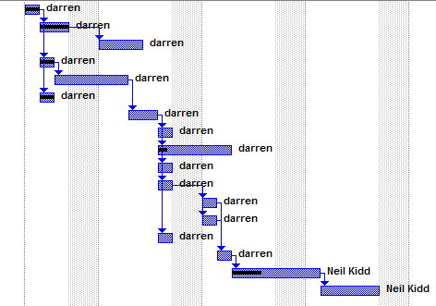

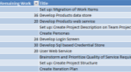




Example Workflow
Bugs
Non Functional Requirements
Test
Use Case
Tasks
Business
Analyst
Dev Team
Change
Requests
Project
Manager
Production
Errors
Operations

Slide 18














Access TFS from ...
*
*
*
*
* Requires 3rd party client
Notes:
Put the data in the server and access it through whichever application suits you best

Slide 19
Example Work Item Types
Work Items
Use Cases
Non Functional Requirements
Risks
Change Requests
Tasks
Bugs
...

Slide 20

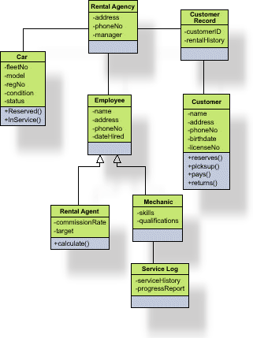

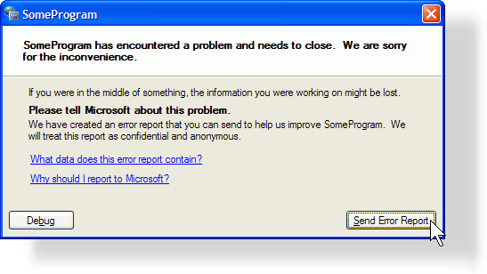
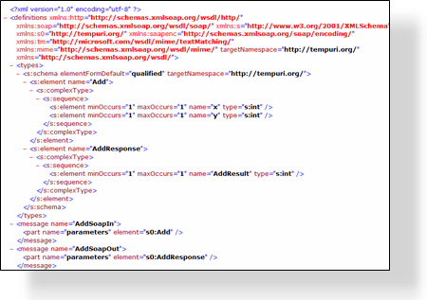




What is in a Work Item?
Proposed
Title
Description
Current State
Active
Active
Attachments
Use Case
Tasks
Bugs
Resolved
Who it is assigned to
Resolved
Links to other Work Items
Full Audited history
Closed
Closed
Anything else you want …

Slide 21
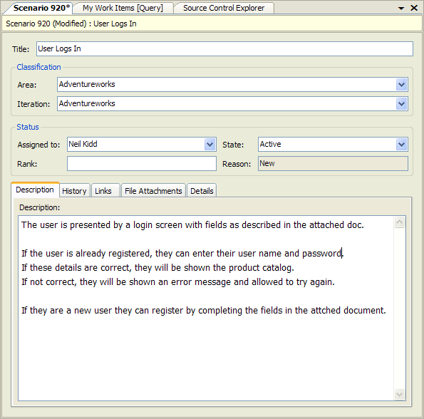
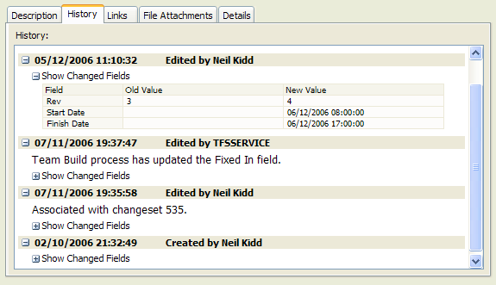
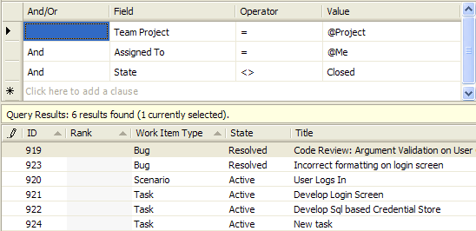
Work Item User Interface

Slide 22

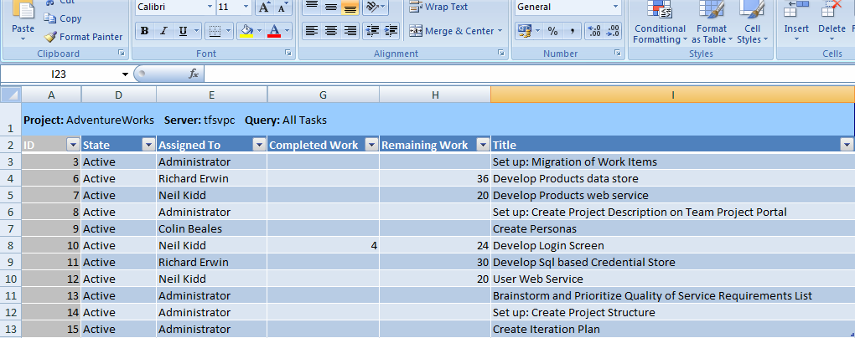
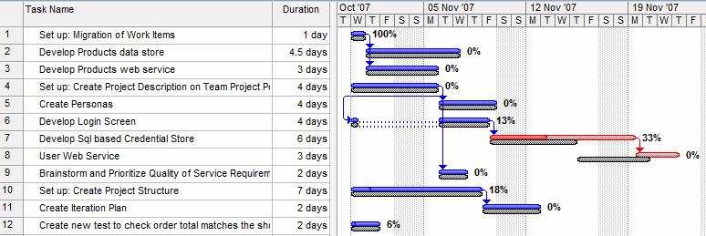
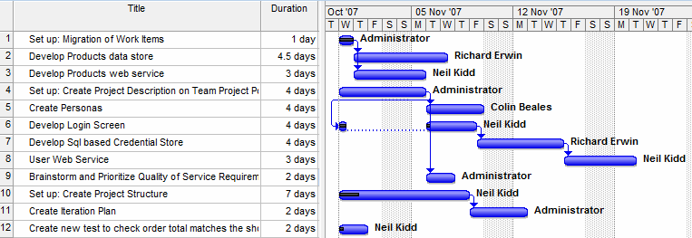
MS Project

Slide 23
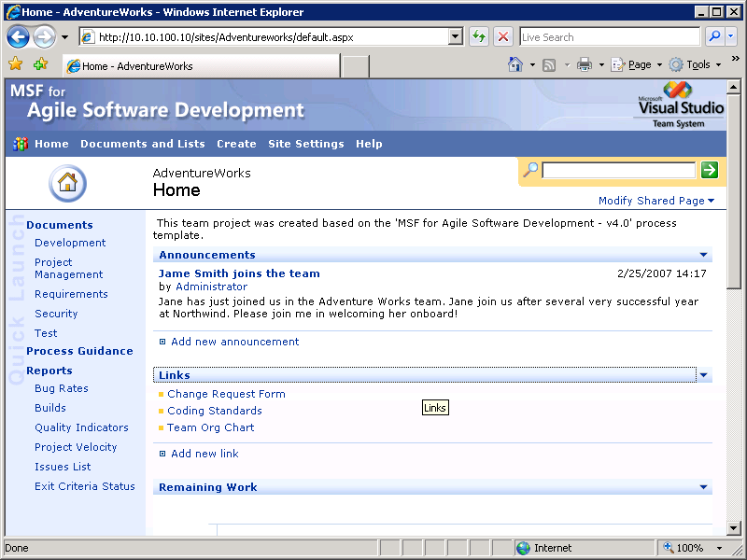
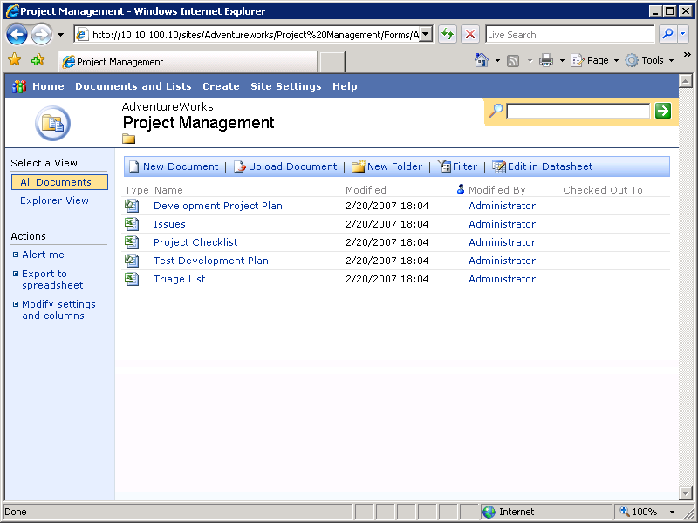
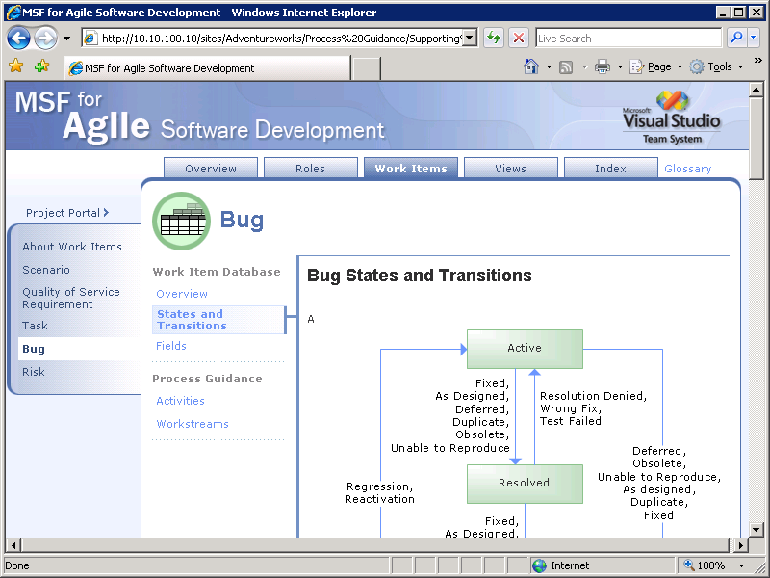
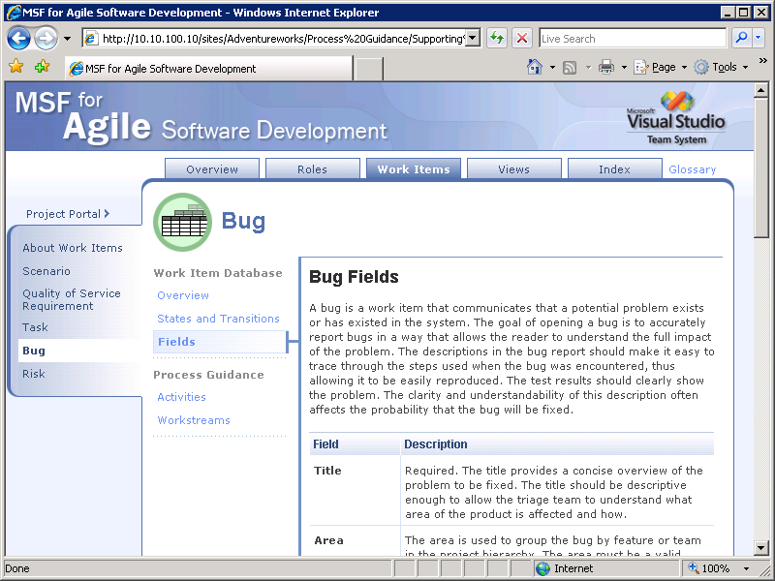
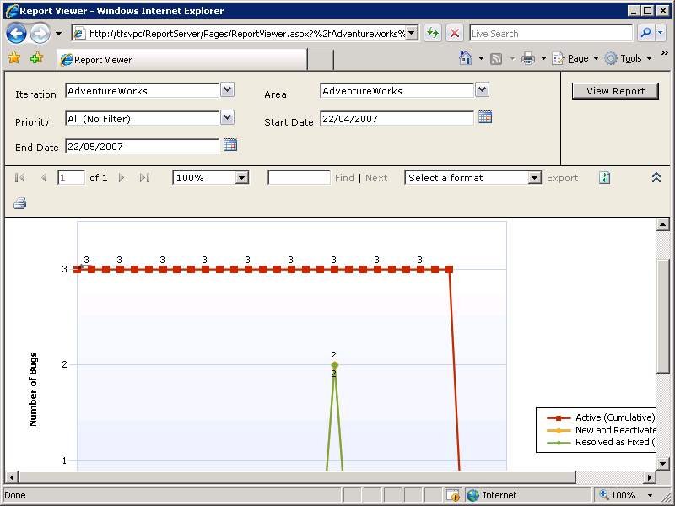
SharePoint

Slide 24
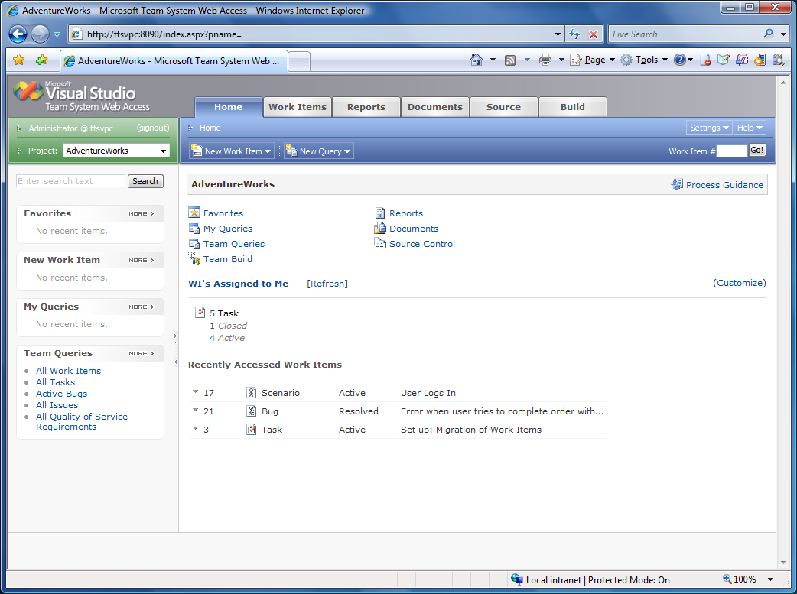
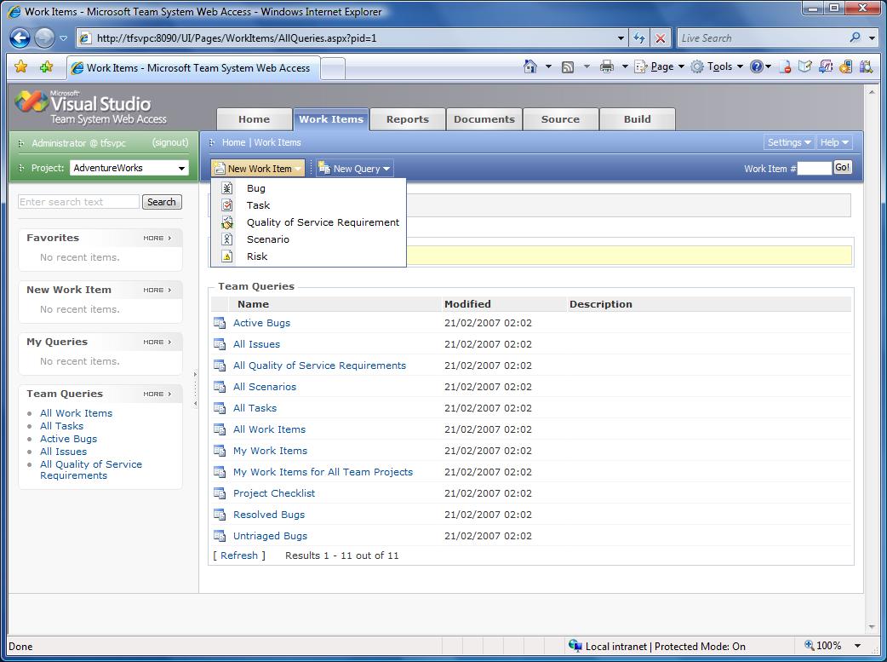
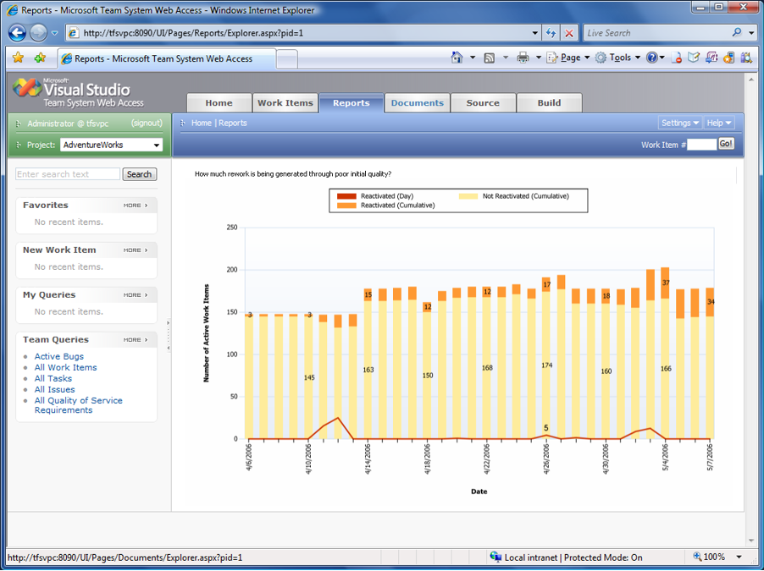
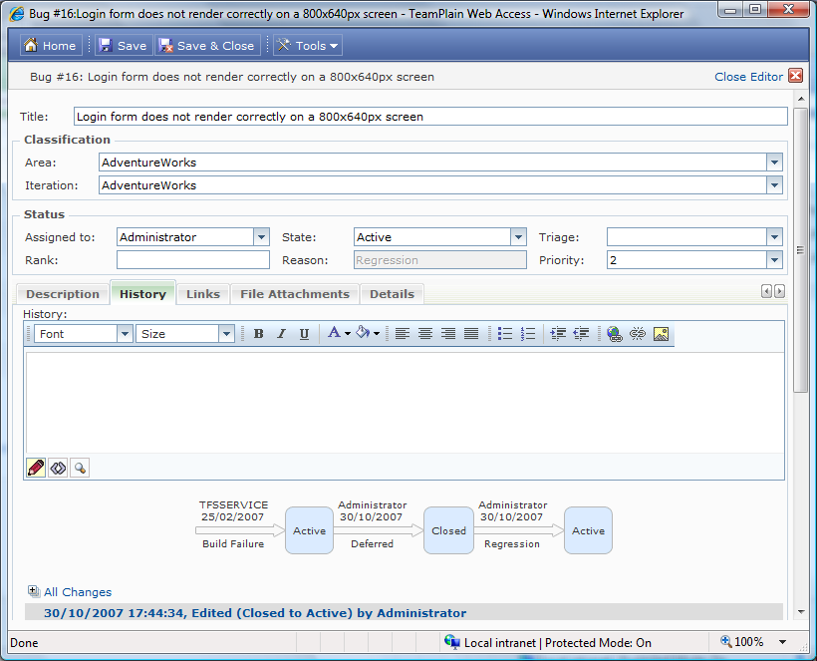
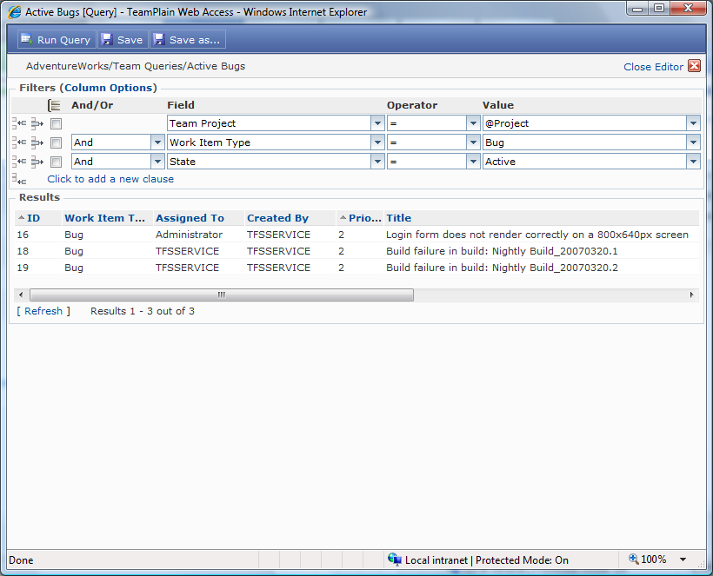
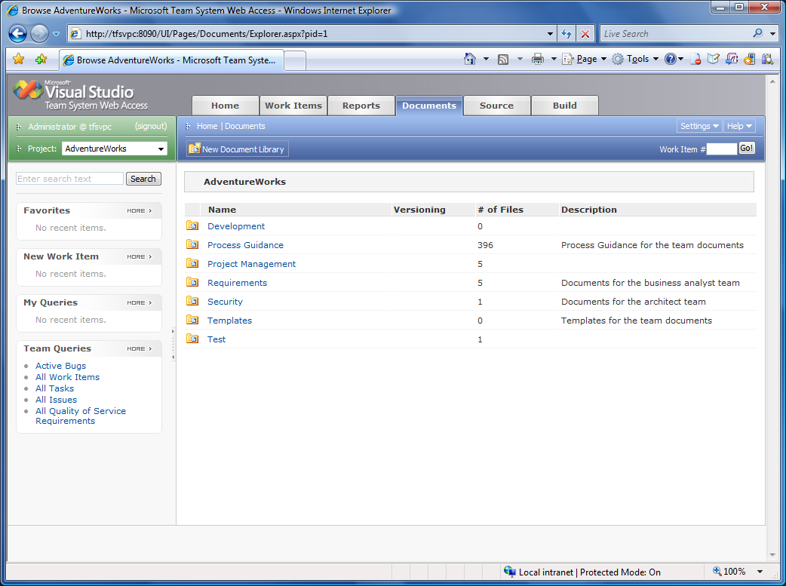
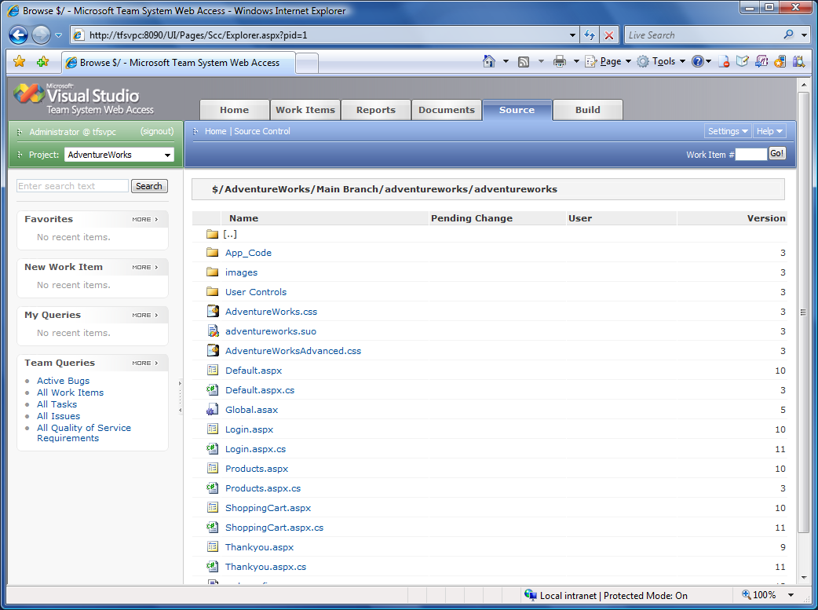
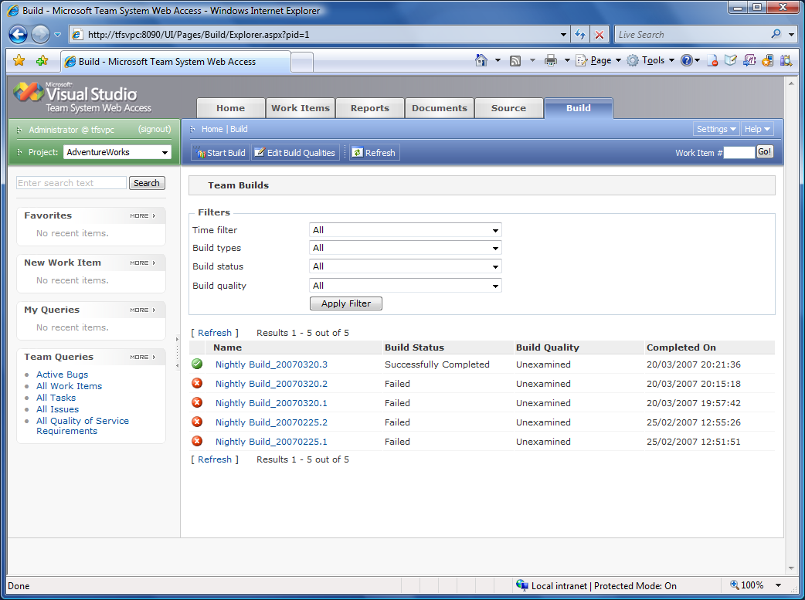
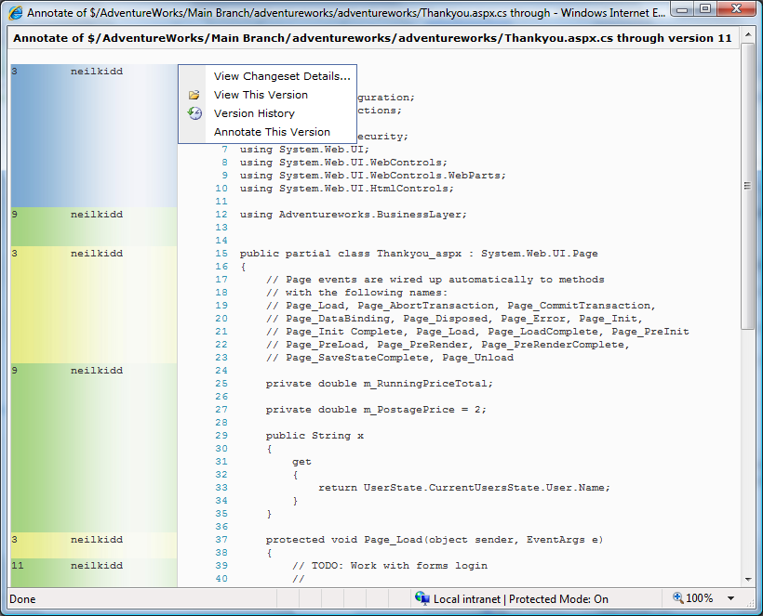
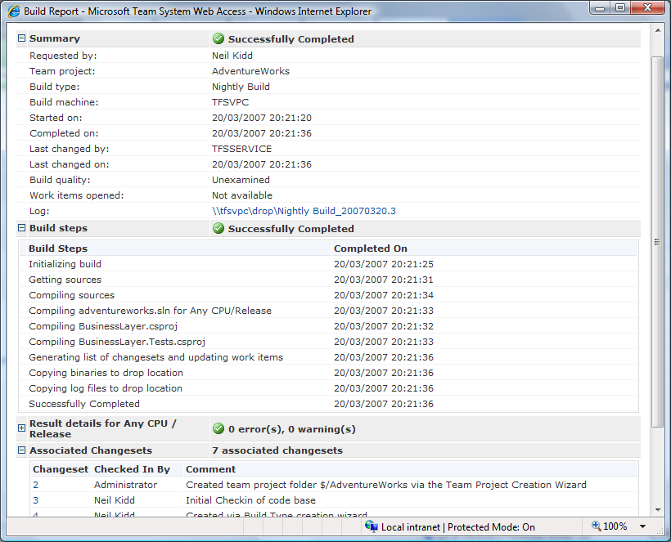
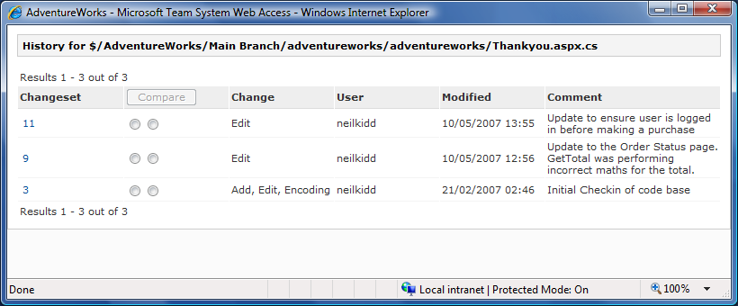
Web Access

Slide 25
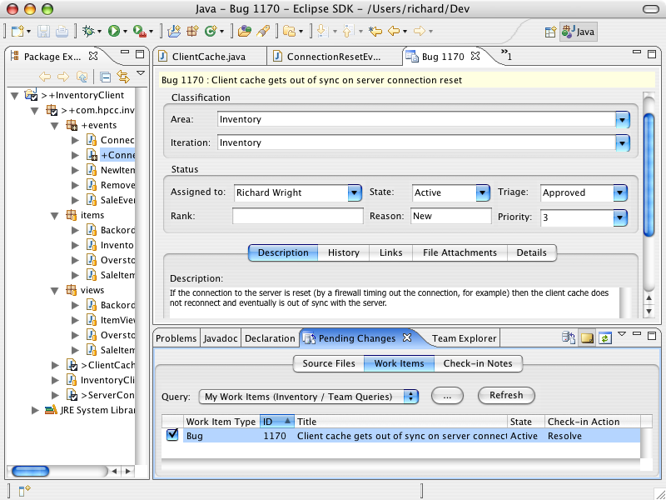
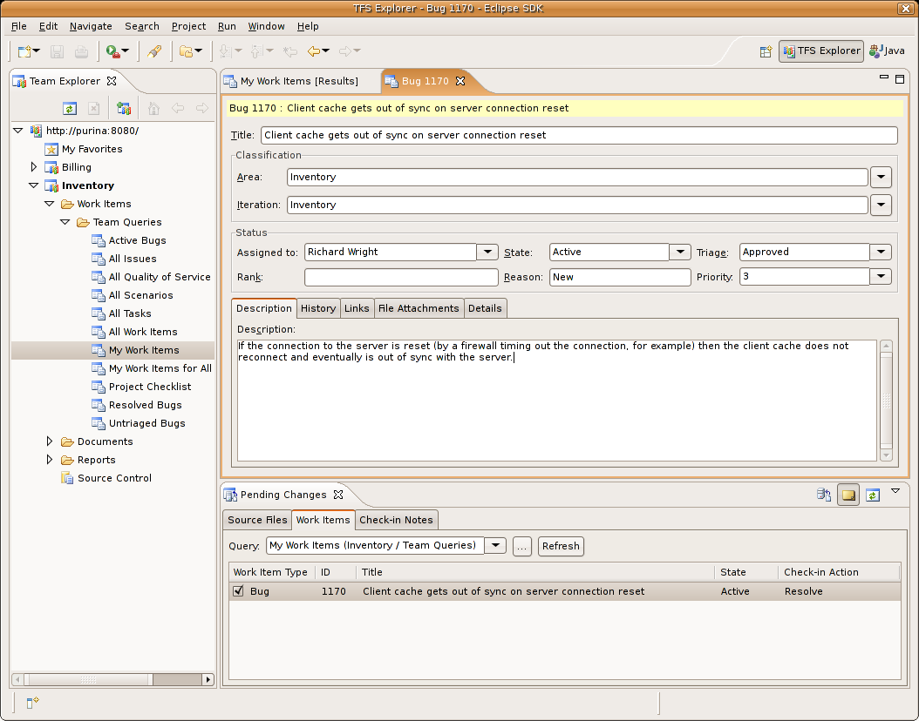
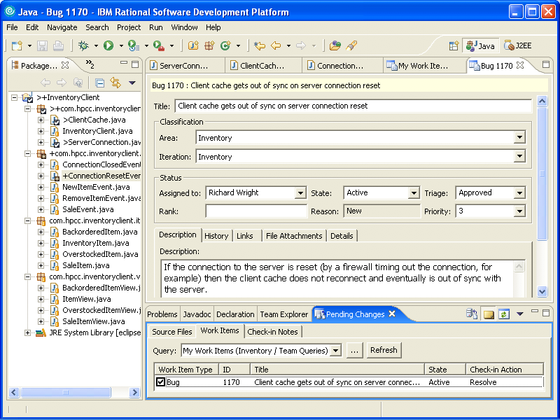

Multi Platform

Slide 26
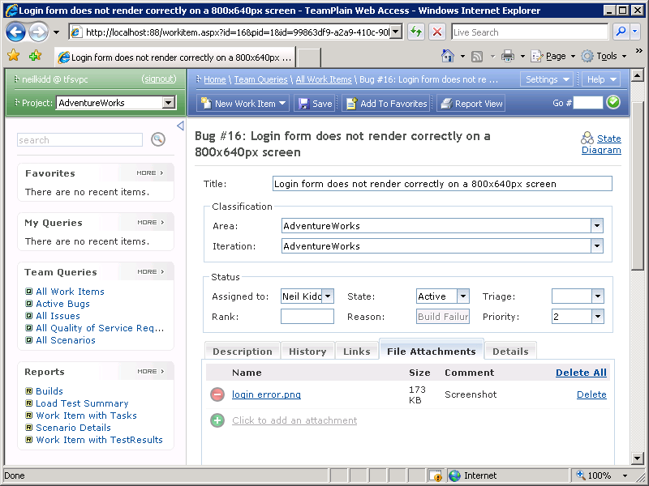
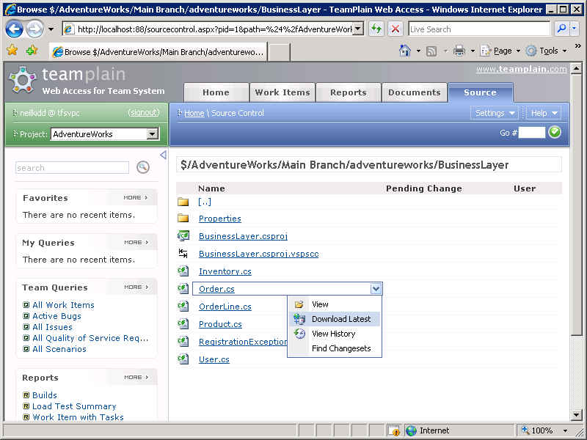
Web Interface

Slide 27
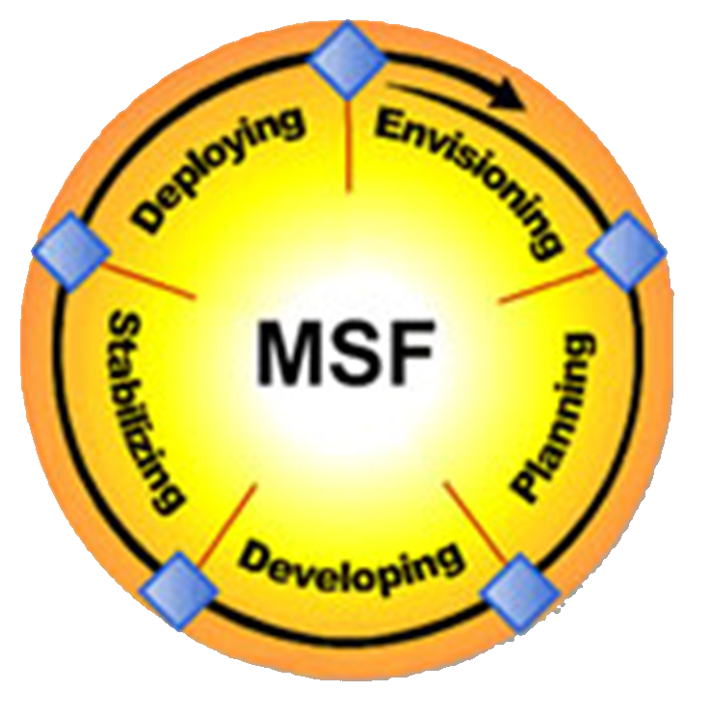
Process Template
Configures TFS to support your Development Process
MSF Agile and MSF for CMMI
Several 3rd party templates
Scrum, RUP, EssUP, XP, ThoughtWorks, Avanade …
Create your own or modify an existing one
Stored in an XML file
Process Template Editor tool

Slide 28
Process Templates
Configures:
Types of Work Items
Use Case, Task, Bug, Change Request, …
Contents of each Work item Type
UI for each Work Item Type
Process Guidance documentation
Layout for SharePoint Portal
Types of Reports

Slide 29
Software Quality

Slide 30
Cost of Bugs
Cost / £
Development
Testing
UAT
Released
Lifecycle stage

Slide 31





Developers Time
80% Debugging
20% Coding
Q: What if we could reduce debugging by 25%?
60% Debugging
40% Coding
A: We double the amount of code we can write

Slide 32




When to test?
Design
Develop
Develop
Test
Test

Slide 33




Test Early & Test Often
Design
Develop
Test
Design
Develop
Test
Design
Iteration 1
Develop
Iteration 2
Test
Iteration 3

Slide 34




Source Code Repository
Built new from the ground up
Not based on SourceSafe
SQL Server 2005 data store
Checkin Policies
Work Item association
Unit Testing
Static Analysis
Shelving
Not just for Visual Studio 2005/8
Remote Proxy Server
Migration tools for code and history
*

Slide 35
Build Process
Scheduled Build
Continuous Integration
Build Process
Compile Code
Execute Unit Tests
Static Code Analysis

Slide 36
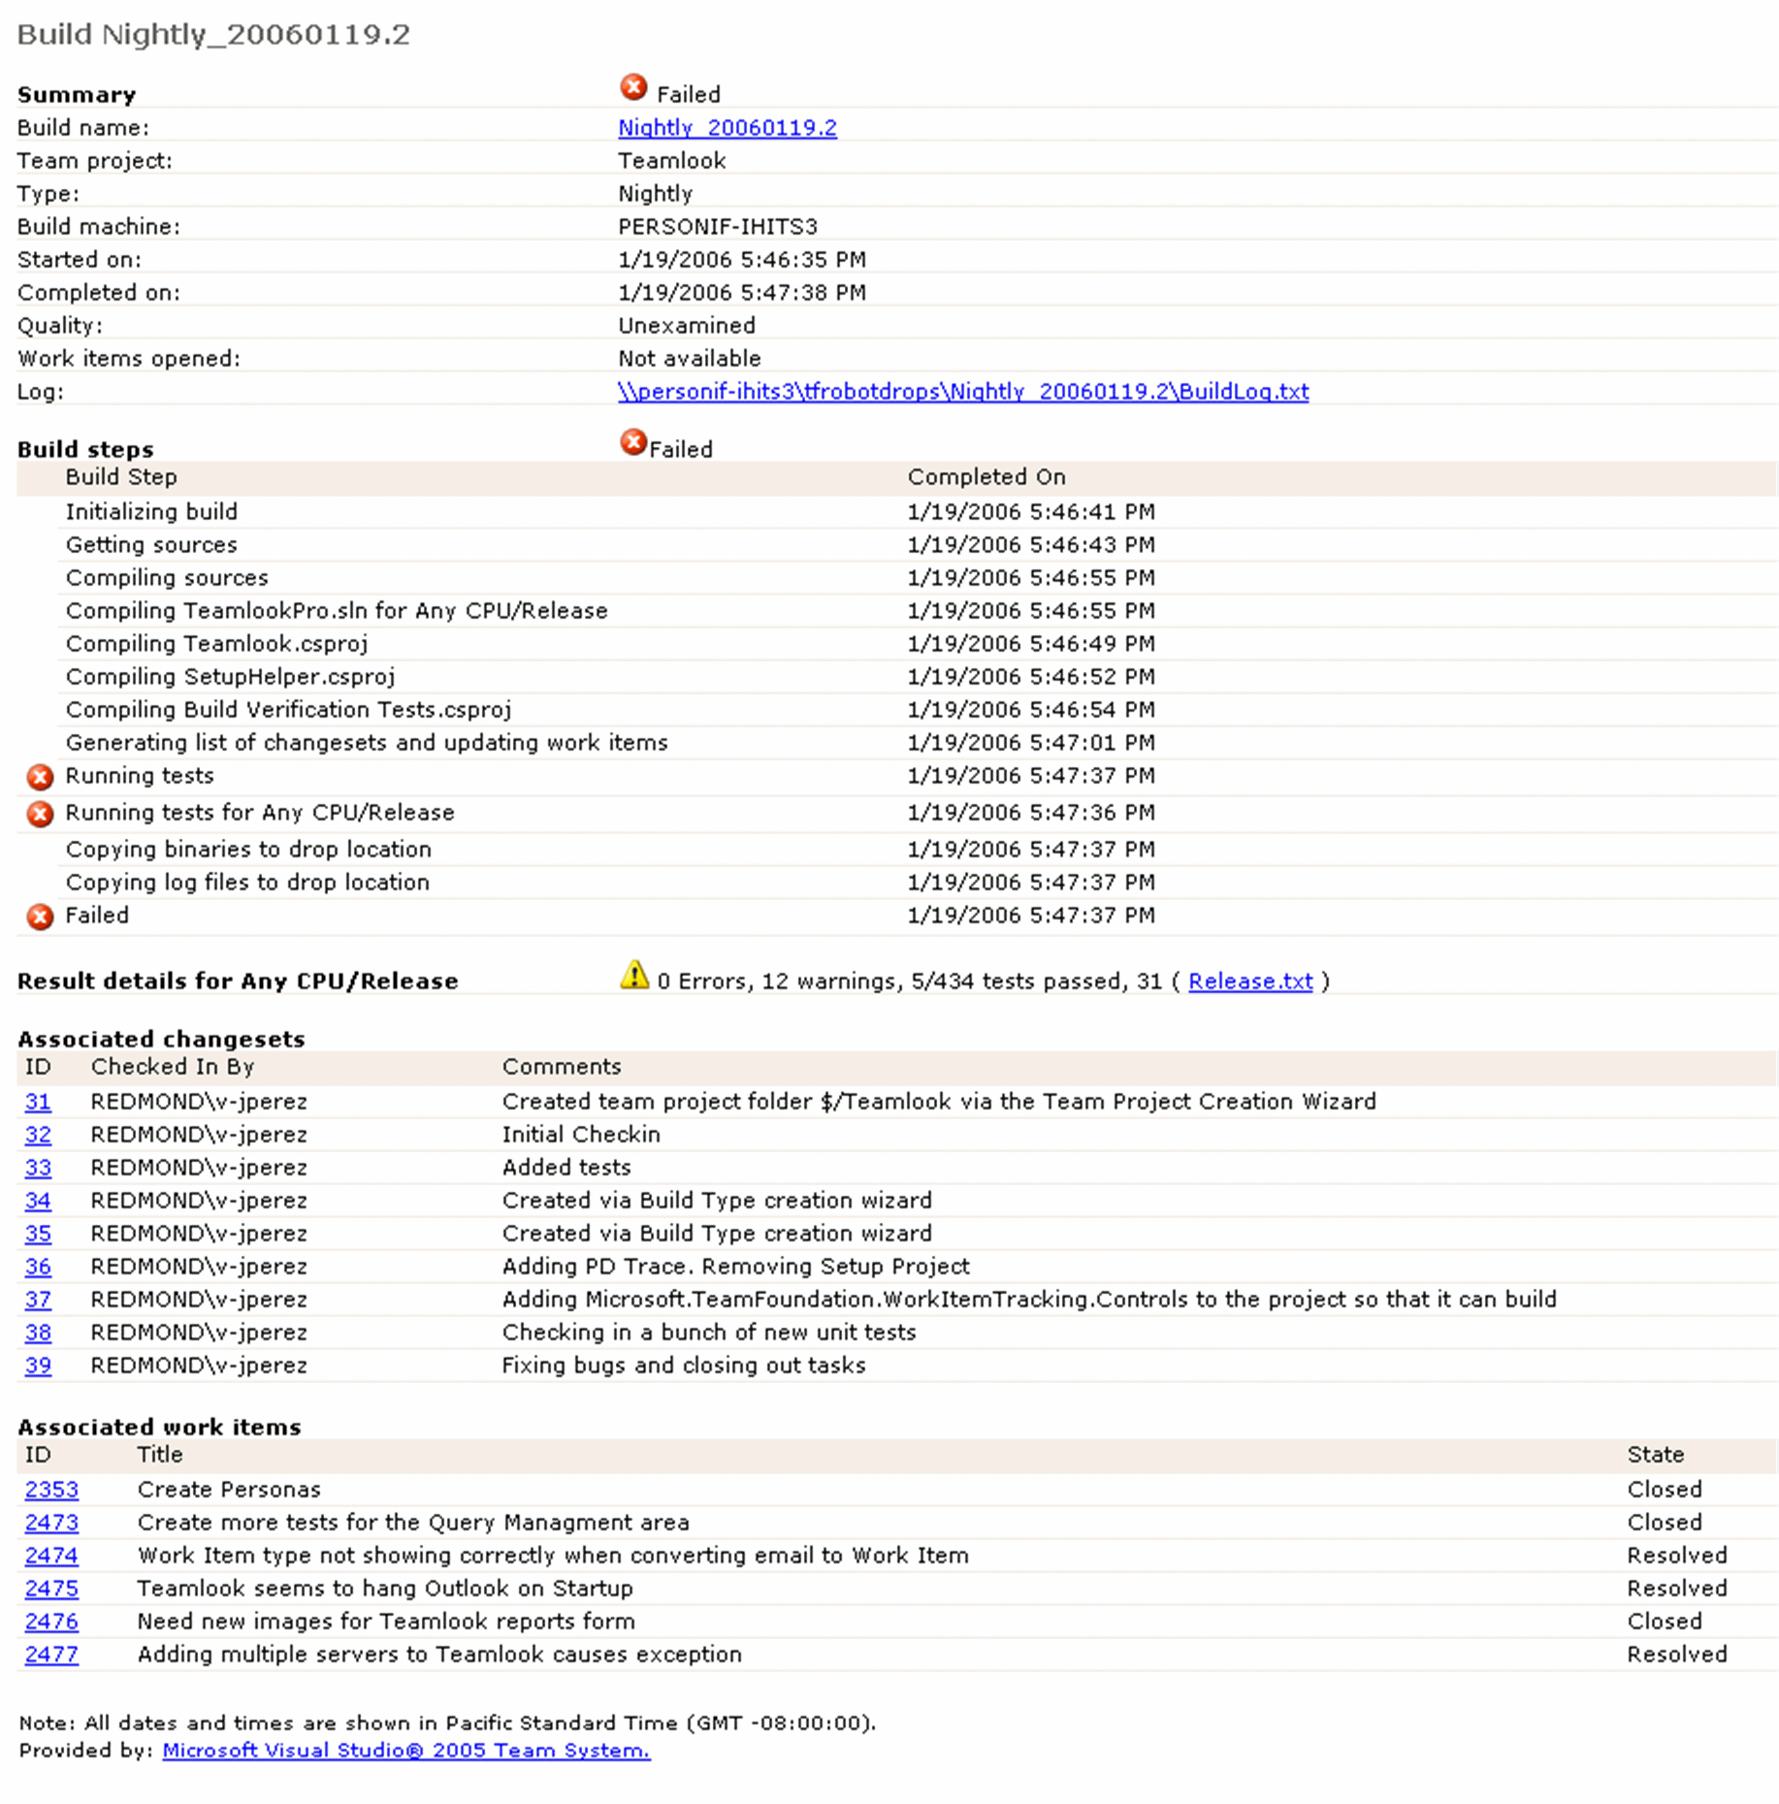
What went into the build?

Slide 37
Build Process
Extensible Build Process
Compile Code
Execute Unit Tests
Static Code Analysis
Build Virtual Server
Configure Web Site / Services
Install Application
Deploy Database
Generate Test Data
System or Load test Entire application

Slide 38
Project Transparency

Slide 39
Measuring Quality
Code Coverage
Active Bugs
Code Churn
100%
% Unit Test Passing
0%
Application Areas

Slide 40
Integrated Reporting
*
*
Project
Structure
Iteration
Structure
*
*
Build
*
Work
Item
*
*
*
Test
Result
*
*
*
*
*
Latest
Version
Changeset
Label
Versioned
Item

Slide 41
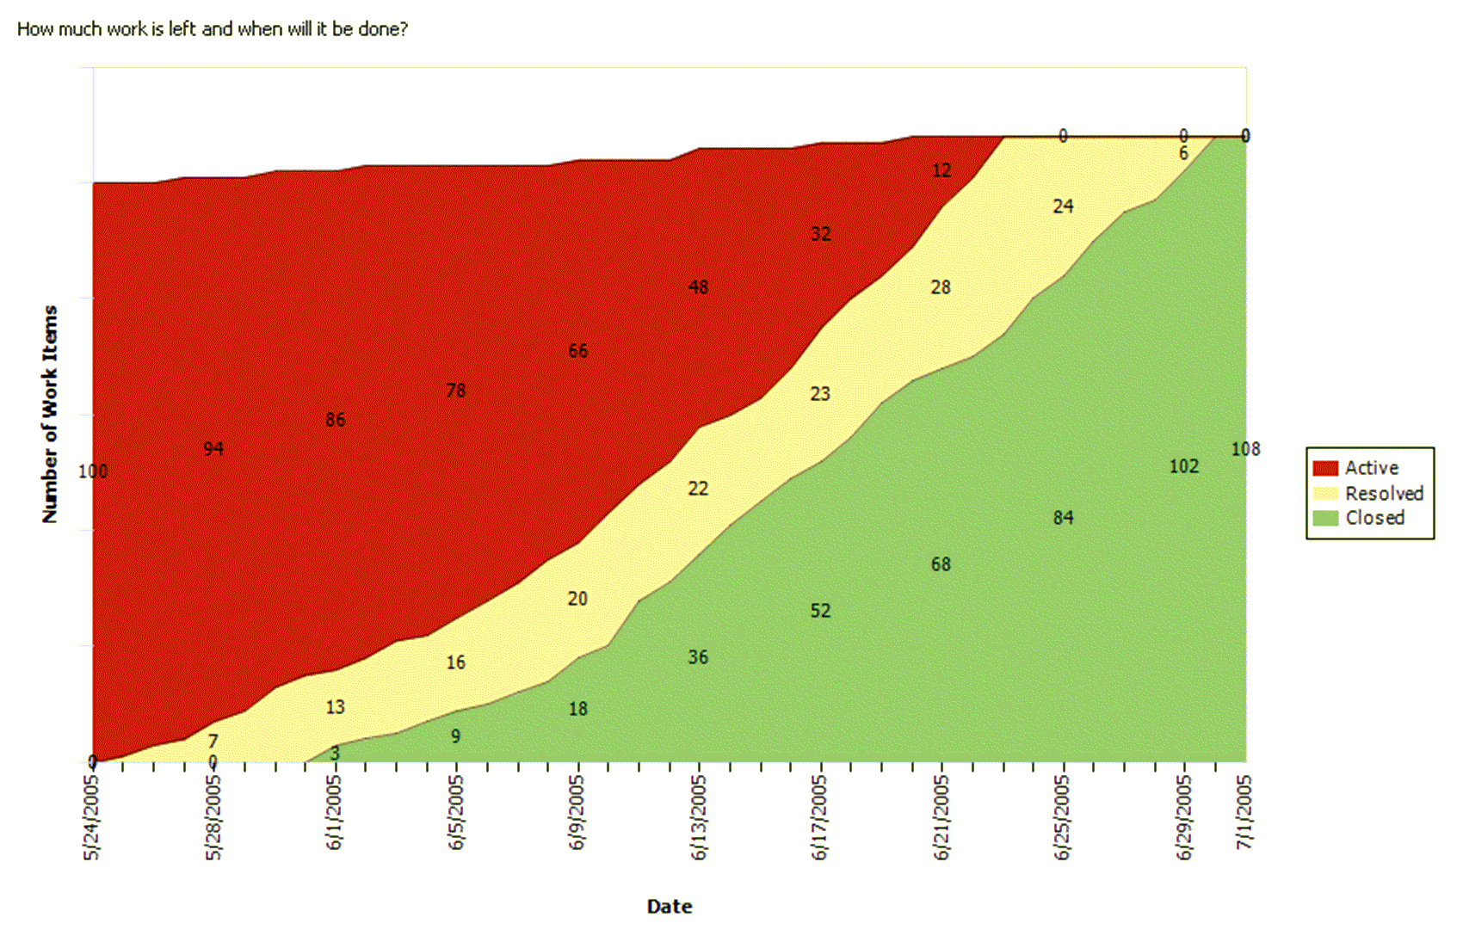
Project Velocity

Slide 42
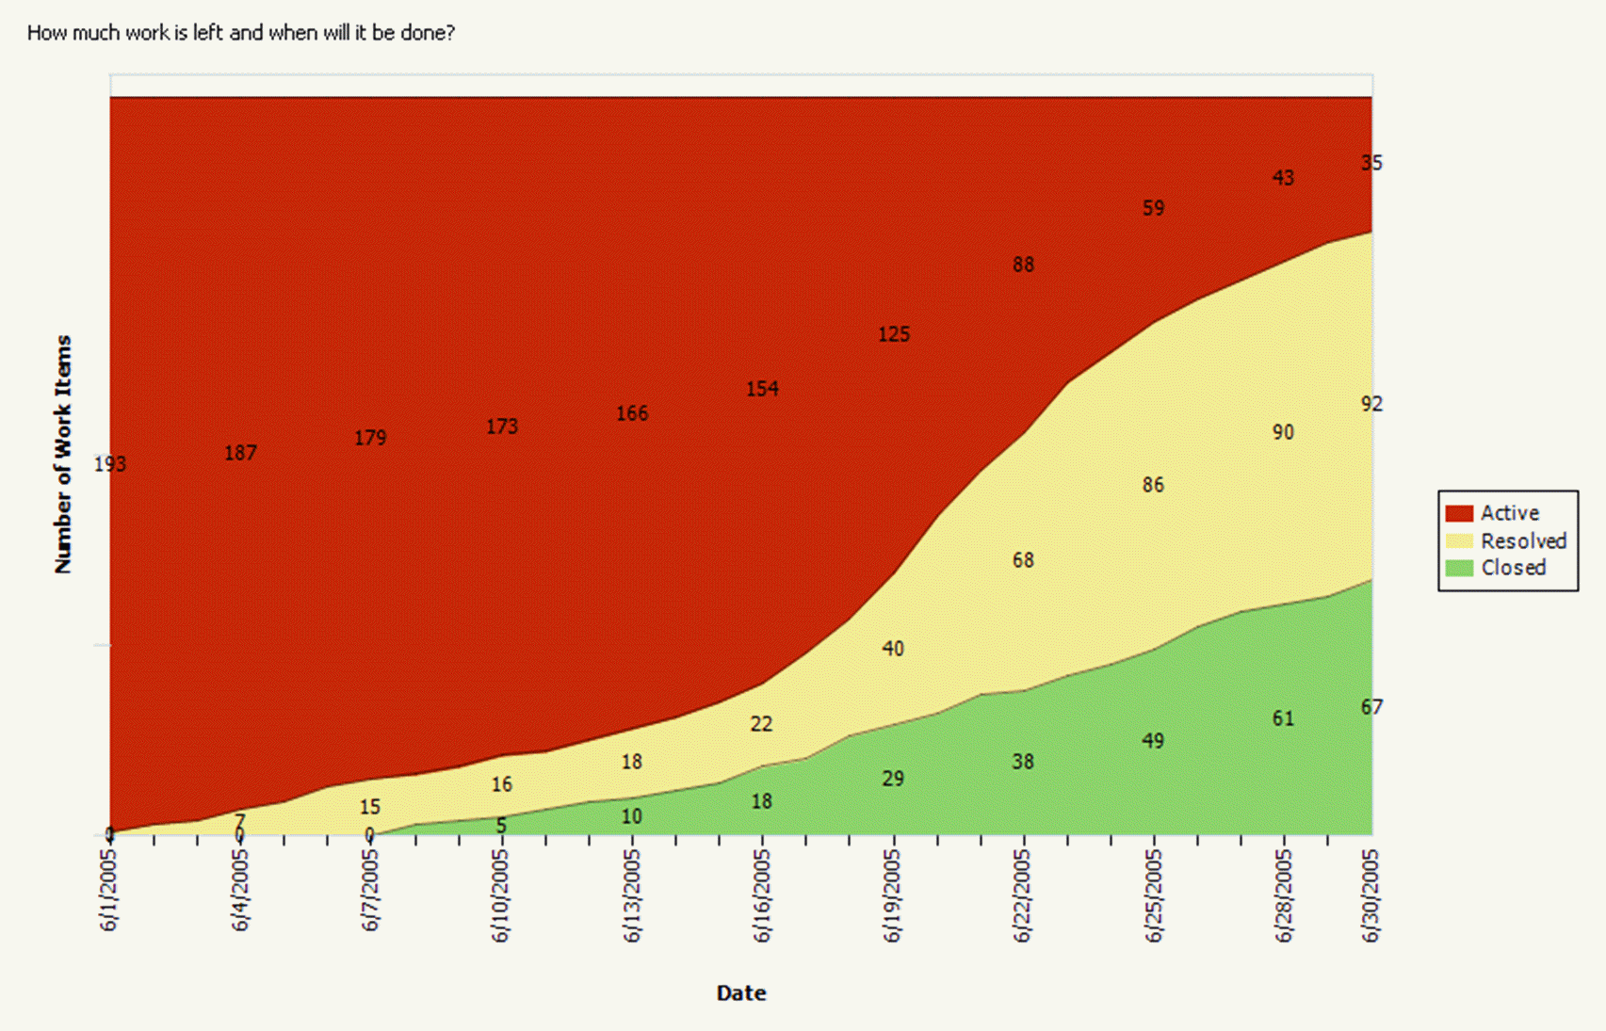
Where Do We Need To Shift Resources?

Slide 43
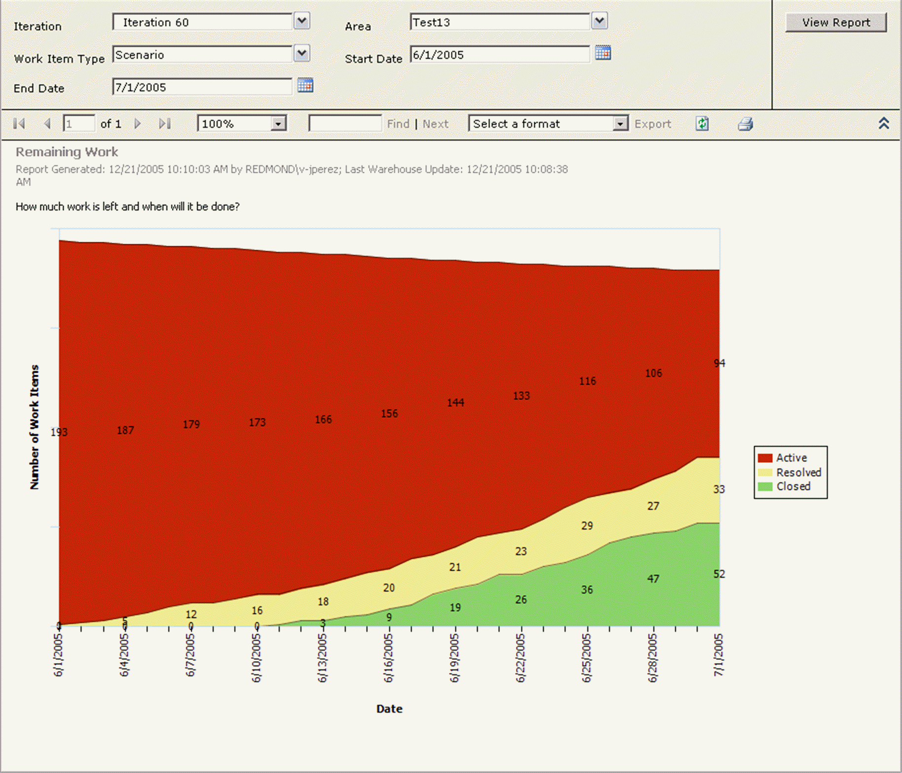
Underestimating

Slide 44
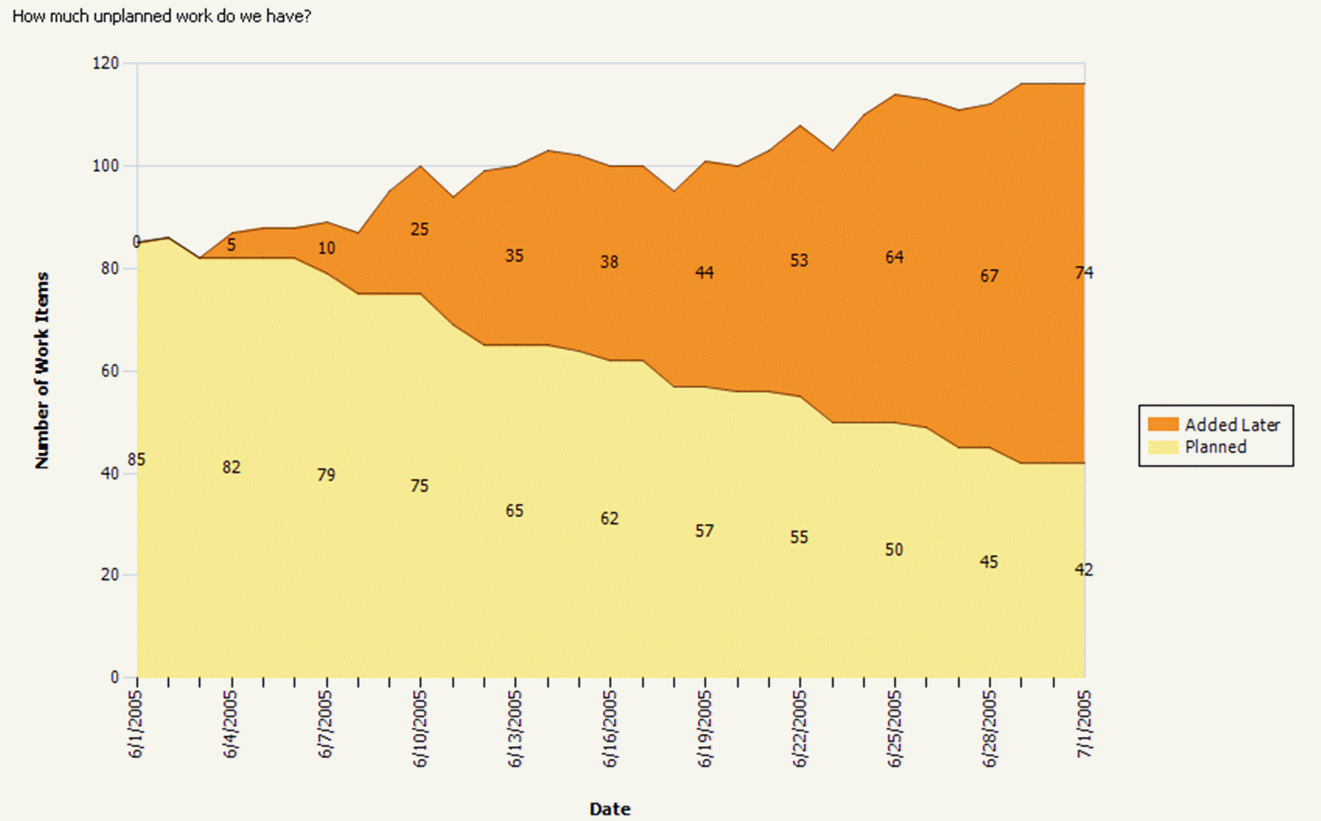
Scope Creep

Slide 45




Does it Work?
ROI: 512%
Payback: 3 months
Social Networking Site
Microsoft Developer Division runs on it:
3,187 Users
116 million files & 28 million folders
1.5TB when compressed!
42 million download per week
299,000 Work Items
SQL Server team use it
Office team moving now
Windows are just starting to move
ROI: 286%
Payback: 4 months
EDS
Project Managers can
manage 2-3 times as
many projects
Global Manufacturer
DBPro cut dev time in half
ConfigureSoft
Developers 50% more productive
KBC
ROI: 225%
Payback: 6 months
Dell

Slide 46
Team Clients

Slide 47
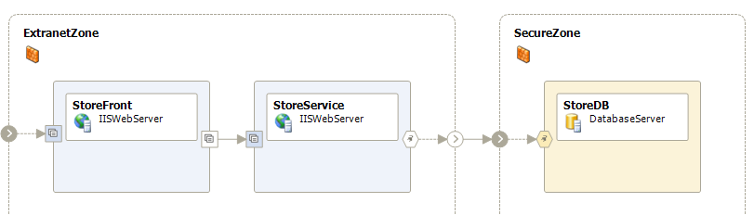
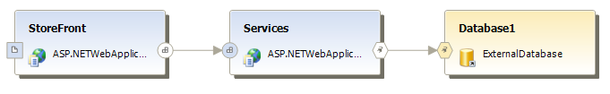
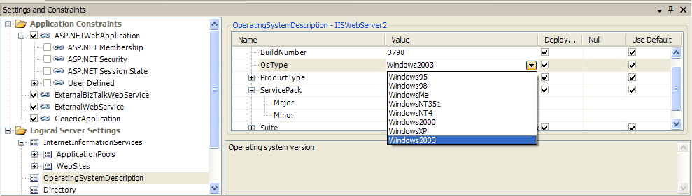
Architect Edition

Slide 48



Architect Edition

Slide 49



Architect Edition

Slide 50





Developer Edition
Integrated Unit Testing
Integrated Static Code analysis
Security Errors
Localisation problems
Memory issues
…
Integrated Profiler
Performance problems
Memory problems

Slide 51



Developer Edition

Slide 52

Database Edition
Take control of database change
Offline, change management of the schema
Refactoring of database objects
Automate database testing
Unit testing for Stored Procs
Automatic generation of meaningful test data
Bring data professionals into the lifecycle
Work Item tracking for database changes

Slide 53

TFS Object Access Model
Client Apps,Team Explorer
TFS Object Model

Slide 54
Sorular , yorumlar,
Aklınıza gelenler ?

Slide 55
Sorular , yorumlar,
Aklınıza gelenler ?
Teşekkürler.

